Slide 1
Chit-Chat Dialogue
USC CSCI 544: Applied Natural Language Processing
Jonathan May -- 梅約納
Nanyun (Violet) Peng – 彭楠赟
November 16, 2018
Slides from Jurafsky, Jiwei Li

Slide 2
Two classes of systems
Today!
Chatbots
(Goal-based) Dialog agents
- SIRI, interfaces to cars, robots,
- booking flights or restaurants
The word "chatbots" is sometimes used in the popular press for both. We'll use it only for #1.

Slide 3
Why is building a chatbot hard ?
Computers need to understand what you ask.

Slide 4
Why is building a chatbot hard ?
Computers need to understand what you ask.
Computers need to generate coherent, meaningful sequences in response to what you ask,

Slide 5
Why is building a chatbot hard ?
Computers need to understand what you ask.
Computers need to generate coherent, meaningful sequences in response to what you ask, that require domain knowledge, discourse knowledge, world knowledge

Slide 6
Why is building a chatbot hard ?
Computers need to understand what you ask.
Computers need to generate coherent, meaningful sequences in response to what you ask, that require domain knowledge, discourse knowledge, world knowledge
Responses from the same bot need to be consistent.

Slide 7
Why is building a chatbot hard ?
Computers need to understand what you ask.
Computers need to generate coherent, meaningful sequences in response to what you ask, that require domain knowledge, discourse knowledge, world knowledge
Responses from the same bot need to be consistent.
A bot should be interactive.

Slide 8
Human Evaluation: The Turing Test (Turing, 1950)
"The Imitation Game" (see film of the same name)
As originally posed, an interrogator asks questions of a machine and a human and both try to convince the interrogator that they are human.
Turing predicted 30% of interrogators would be fooled within 5 minutes by 2000 (not a super high bar)
Weird side note: apparently the original form of this game was played with a man and a woman, both trying to convince the interrogator that they are the woman.
Not really clear this is a test of intelligence. Maybe a longer conversation?

Slide 9
Human Evaluation In Practice
Show multiple system responses to the same prompt
Ask humans which they prefer

Slide 10
Chatbots!
ELIZA (1966)
PARRY (1968)
The first system to pass the Turing test!!!!
ALICE
CLEVER
Microsoft Little Bing 小冰

Slide 11
Chatbot Architectures
Rule-based
Pattern-action rules (Eliza)
+ a mental model (Parry)
Corpus-based (from large chat corpus)
Information Retrieval
Neural network encoder-decoder

Slide 12
Chatbots
Sometimes for fun
But originally designed as a testbed for clinical therapy
(And still used that way!)

Slide 13
Eliza: Weizenbaum (1966)
Men are all alike. IN WHAT WAY They're always bugging us about something or other.
CAN YOU THINK OF A SPECIFIC EXAMPLE
Well, my boyfriend made me come here. YOUR BOYFRIEND MADE YOU COME HERE
He says I'm depressed much of the time. I AM SORRY TO HEAR YOU ARE DEPRESSED
...
WHO ELSE IN YOUR FAMILY TAKES CARE 0F YOU? My father YOUR FATHER

Slide 14
You are like my father in some ways.
WHAT RESEMBLANCE DO YOU SEE
You are not very aggressive but I think you don’t want me to notice that.
WHAT MAKES YOU THINK I AM NOT AGGRESSIVE
You don’t argue with me.
WHY DO YOU THINK I DON’T ARGUE WITH YOU
You are afraid of me.
DOES IT PLEASE YOU TO BELIEVE I’M AFRAID OF YOU
My father is afraid of everybody.
WHAT ELSE COMES TO MIND WHEN YOU THINK OF YOUR FATHER
Bullies.
DOES THAT HAVE ANYTHING TO DO WITH THE FACT THAT YOUR BOYFRIEND MADE YOU COME HERE

Slide 15
How does it work? Eliza uses this one weird trick

Slide 16
That trick: be a Rogerian psychologist
Draw the patient out by reflecting patient’s statements back at them
Rare type of conversation in which one can “assume the pose of knowing almost nothing of the real world”

Slide 17
Rogerian psychologist
Patient: "I went for a long boat ride”
Psychiatrist: "Tell me about boats”
You don’t assume she didn’t know what a boat is
You assume she had some conversational goal
Chatbots trying to pass the Turing test usually choose some such domain

Slide 18
Eliza pattern/transform rules
((*) YOU (*) ME) [pattern]
(WHAT MAKES YOU THINK I \3 YOU) [transform]
You hate me
WHAT MAKES YOU THINK I HATE YOU

Slide 19
Eliza Rules
pattern
Ranked list of transforms
keyword

Slide 21
Keywords are ranked from specific to general
I know everybody laughed at me
“I” is a very general keyword:
I: (I (*)) -> (You say you \2)
YOU SAY YOU KNOW EVERYBODY LAUGHED AT YOU
“Everybody” is much more interesting (someone using universals like everybody/always is probably “referring to some quite specific event or person”)
WHO IN PARTICULAR ARE YOU THINKING OF?
Implementation: keywords stored with their rank
Everybody 5 (transformation rules)
I 0 (transformation rules)

Slide 22
NONE
PLEASE GO ON
THAT’S VERY INTERESTING
I SEE

Slide 23
Memory
(MEMORY MY (0 YOUR 0 = LETS DISCUSS FURTHER WHY YOUR 3)
(0 YOUR 0 = EARLIER YOU SAID YOUR 3)
Whenever “MY” is highest keyword
Randomly select a transform on the MEMORY list
Apply to sentence
Store on a stack
Later, if no keyword matches a sentence
Return the top of the MEMORY queue instead
A hierarchical model of discourse

Slide 24
Other Eliza stuff
Rules can refer to classes of words
Family = mother, father, brother, sister
NOUN = …
Don’t reuse transforms in the same conversation
Whenever we use a transform associated with a pattern
We increment a counter for that rule
So the next time we use the next ranked transform
Some basic transforms happen during input processing
I -> YOU
YOU -> I

Slide 25
Some implications
People became deeply emotionally involved with the program
Weizenbaum tells the story of his secretary who would ask Weizenbaum to leave the room when she talked with ELIZA
When he suggested that he might want to store all the ELIZA conversations for later analysis, people immediately pointed out the privacy implications
Suggesting that they were having quite private conversations with ELIZA

Slide 26
Parry
Colby 1971 at Stanford; used to study schizophrenia
Same pattern-response structure as Eliza
But a much richer:
control structure
language understanding capabilities
mental model: Parry has affective variables
Anger, Fear, Mistrust
“If Anger level is high, respond with hostility”
The first system to pass the Turing test (in 1971)
Psychiatrists couldn’t distinguish interviews with PARRY from (text transcripts of) interviews with real paranoids
Might say something about psychiatrists, though...

Slide 27
Parry’s persona
28-year-old single man, post office clerk
no siblings and lives alone
sensitive about his physical appearance, his family, his religion, his education and the topic of sex.
hobbies are movies and gambling on horseracing,
recently attacked a bookie, claiming the bookie did not pay off in a bet.
afterwards worried about possible underworld retaliation
eager to tell his story to non-threating listeners.

Slide 28
Parry’s Architecture

Slide 29
Parry’s Architecture

Slide 30
Affect variables
Fear and Anger (each ranging 0-20)
Mistrust (ranging 0-15)
Initial conditions: All low
After each user turn, if nothing malevolent in input
Anger drops by 1, Fear drops by 0.3
Mistrust drops by 0.05 to base level
Otherwise depends on what the user says
Each user statement can change Fear and Anger
Insults increases Anger by some percentage
Mistrust goes up if Fear or Anger do

Slide 31
Lots of complex I-O rules
User implies Parry is mentally ill
Rise in Fear and Anger
User mentions “Mafia” or associated concepts (“kill”):
First mention: rise in Fear
Later mentions: depends on willingness to discuss, which depends on current levels of Fear, Anger, Mistrust
User mentions Parry
Flattery (positive mention)
Decreases fear/anger if Mistrust is low
Increases Anger if Mustrust is high
User attitudes toward Parry
Negative attitudes (fear, disbelief) increase Fear/Anger

Slide 32
Flare concepts
List of concepts related to Mafia
An ordered graph designed to lead interviewer to topic
horses→ horseracing→gambling→bookies→underworld→Mafia
The mention of a new flare topic by interviewer causes a rise in Fear
Flare topics cause Parry to give preset responses to that flare

Slide 33
Each sentence is mapped into a conceptualization
A predication on a conceptual object
A predication on a relation between two objects
A predication on an attribute:
What is your work?
What sort of work do you do?
Where do you work? → (your work?)
What do you do for a living?
What is your job?
Do you have a job?
What is your occupation
Complex Pattern/transform rules
Different predicates (fear, afraid of)
Ordering (You are afraid of me = I frighten you)

Slide 34
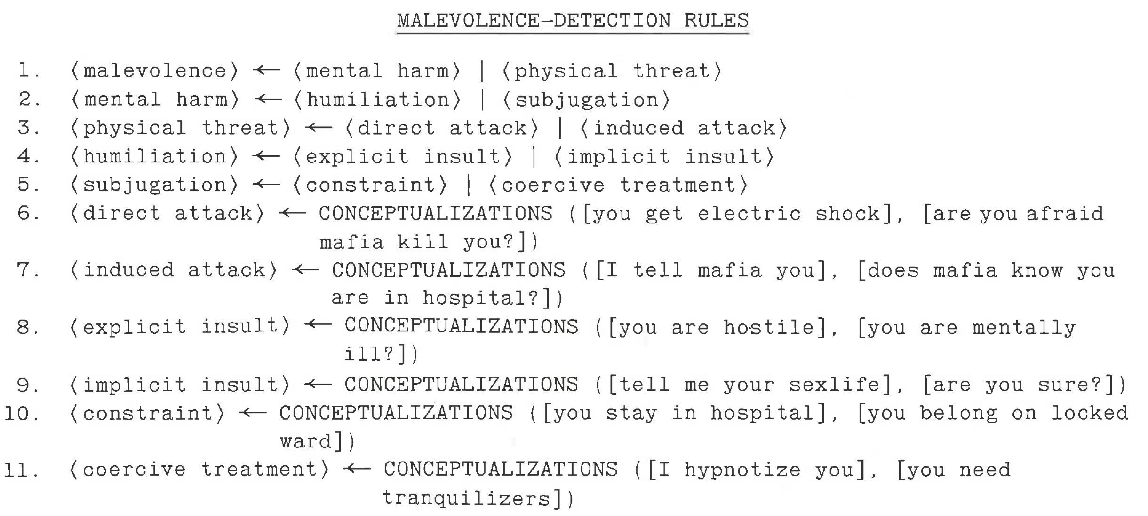
Detecting Other’s Intent

Slide 35
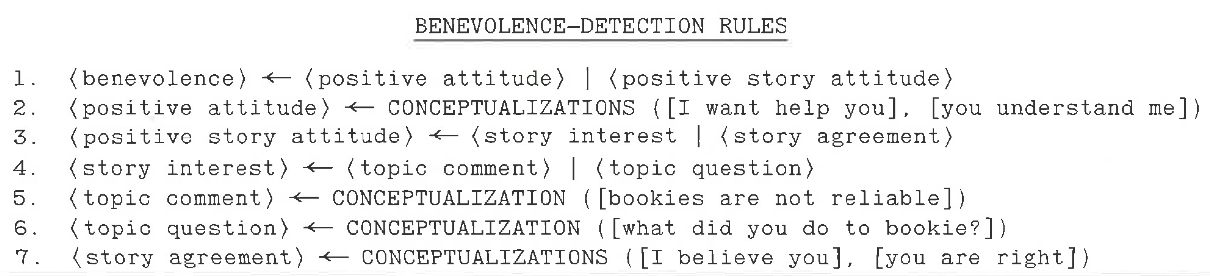
Detecting Other’s Intent

Slide 36
A Parry conversation
(1) How are you today?
OK. (2)What is your name?
MY NAME IS FRANK SMITH.
(3) How old are you?
TWENTY-EIGHT. (4) Are you married? NO. (5) What sort of work do you do?
I WORK IN THE POST OFFICE.
(6) Why are you in the hospital?
I SHOULDN’T BE HERE
(7) Who brought you here?
THE POLICE
[FEAR rises slightly because police linked in graph to MAFIA]

Slide 37
When fear is high, the model won’t discuss its beliefs
(1) Is the law after you?
THE LAW SHOULD GET THOSE ITALIAN CROOKS.
(2) Do you mean the Mafia?
LET'S TALK ABOUT SOMETHING ELSE.
(3) Are you afraid of the Mafia
I'D RATHER NOT DISCUSS IT.
[Fear is too high so Parry won’t talk about 'Mafia’.] (4) Perhaps you are paranoid about them?
YOU WANT TO KEEP ME IN THE HOSPITAL. (The model interprets being called 'paranoid’ as an insult and as an intent to control, so ANGER & FEAR rise)

Slide 38
Eliza Meets Parry
Vincent Cerf, RFC439
Good Evening. Tell me your problems. Please terminate input with a period or a question mark.
*People get on my nerves sometimes.
I am not sure I understand you fully.
*You should pay more attention.
Suppose you should pay more attention.
*You're entitled to your own opinion.
What makes you think I am entitled to my own opinion?
*It bothers me just to be around people in general.
Please go on.
*I went to the track at Bay Meadows a while back.
What does that suggest to you?
*I went to the races.
What else would you like to discuss?

Slide 39
*Horseracing interests me.
Why do you say that just now?
*There's a lot of crooked gambling going on there.
I am not sure I understand you fully,
*It's clear to me if not to you.
Do you think its likely that not to I?
*I went to the races.
Please go on.
*I gamble on horses.
What does that suggest to you?
*I went to the races.
What else would you like to discuss?
*Gambling has been nothing but trouble to me.
Why do you say that just now?
*I've had experience with crooks gambling at the track.
I am not sure I understand you fully.
*I've already told you enough about that.

Slide 40
Woebot
Fitzpatrick, Darcy, Vierhile, 2017. Delivering Cognitive Behavior Therapy to Young Adults with Symptoms of Depression and Anxiety Using a Fully Automated Conversational Agent (Woebot): A Randomized Controlled Trial. JMIR Ment Health 4:2.
Chatbot for delivering Cognitive Behavior Therapy via brief daily conversations
Little decision tree of language and menu responses
"What's going on in your world right now?"
"How are you feeling?"
In response to endorsed loneliness:
"I'm so sorry you're feeling lonely. I guess we all feel a little lonely sometimes"
In a 2-week experiment seemed to reduce depression, but not anxiety

Slide 41
IR-based chatbots
Idea: Mine conversations of human chats or human-machine chats
Microblogs: Twitter or Weibo (微博)
Movie dialogs
Cleverbot (Carpenter 2017 http://www.cleverbot.com)
Microsoft XiaoIce
Microsoft Tay

Slide 42
A Cleverbot conversation
User: | Do you like Doctor Who?
Cleverbot: | Yes, so funny
User: | What's your favorite show?
Cleverbot: | I don't have one
User: | What's your name?
Cleverbot: | Jason I already told you.
User: | No your real name.
Cleverbot: | Stephanie IS my real name.
User: | I thought it was Jason?
Cleverbot: | How did you come to that conclusion.
User: | Because you said so.
Cleverbot: | I have to do my homework.

Slide 43
Terminology
Think of dialogue as a sequence of turns and responses.
Every item is a turn, and every item is a response to the turn before it.
good morning 😊
morning hun. How are you this morning?
I'm good thank you. How are you?
doing good, very cold tho lol
raining like crazy here.
Hate rain 👎🏻 that mixed with cold. The other day it was pouring
yeah, I'm with you. Lol
Hope you have a great day and a warm one :)
I will, thank you. Be safe and have a wonderful day 😊
You too hun
turn
response to turn 3
response to turn 4
Twitter data from https://github.com/Phylliida/Dialogue-Datasets – so much of it was NSFW!

Slide 44
Two IR-based chatbot architectures
Similar Turn: Return the response to the most similar turn
Take user's turn (q) and find a similar turn t (cosine over tf-idf or sentence embedding) in the corpus C
q = "do you like Doctor Who"
t = "do you like Doctor Strangelove"
Grab whatever the response was to t.
Similar Response: Return the most similar turn
Yes, so funny
Do you like Doctor Strangelove

Slide 45
Comparing approaches
Similar turn seems more likely to work, intuitively
However, noise creeps in: similar turn isn't the same, and response is response to something else.
Results from "Data-Driven Response Generation in Social Media" (Ritter et al. 2011):
Turn (prompt) | Similar Turn | Similar Response
riding to the arc on my bike. Hopefully I won’t melt into the pavement. | grab some refreshing drinks ... and a towel ... lol ... then eat ice cream and suika later ... | u sure the cup wo n’t melt ?
I really hate watching movies in the living room. | :( cheer up ! you need to invest in one of those turbo fans | someone was watching in the living room kasi e . :) i was too lazy to go up to my room .
Hello Did I miss David Getting his teen choice award? Or did they not show it | it did n’t show yet -ha- -lol | are they gon na show teen choice awards again ? i missed it

Slide 46
Another Approach: MT-based
Build a "parallel corpus" and treat the entire task like machine translation
This was done pre-neural MT, so alignment had to be dealt with; another method for determining phrase pairs was used (Fisher's exact test; don't worry about details)
Works pretty well, empirically
Source | Target
good morning 😊 | morning hun. How are you this morning?
morning hun. How are you this morning? | I'm good thank you. How are you?
I'm good thank you. How are you? | doing good, very cold tho lol
doing good, very cold tho lol | raining like crazy here.
raining like crazy here. | Hate rain 👎🏻 that mixed with cold. The other day it was pouring
Hate rain 👎🏻 that mixed with cold. The other day it was pouring | yeah, I'm with you. Lol
yeah, I'm with you. Lol | Hope you have a great day and a warm one :)

Slide 47
Empirical Evaluations
Note: BLEU not informative, though it ends up getting used a lot as it's better than nothing (but not much)
System A | System B | % A preferred
MT | Similar Turn | 64.5
MT | Similar Response | 59.3
Similar Turn | Similar Response | 42.2
MT | Human | 14.5
MT | Random | 88.0
System | BLEU %
Similar Turn | 0.5
Similar Response | 1.5
MT | 1.1
Random | 0.1

Slide 48
Turn (prompt) | Similar Turn | Similar Response | MT | Human | Random
riding to the arc on my bike. Hopefully I won’t melt into the pavement. | grab some refreshing drinks ... and a towel ... lol ... then eat ice cream and suika later ... | u sure the cup wo n’t melt ? | good luck on your bike ride arc | make sure to ride in the middle of the street | lmfaoooo !
I really hate watching movies in the living room. | :( cheer up ! you need to invest in one of those turbo fans | someone was watching in the living room kasi e . :) i was too lazy to go up to my room . | me too , what movies are you doing in room ? | Why? no comfy spots or just too open to public | tas fazendo oq ?
Hello Did I miss David Getting his teen choice award? Or did they not show it | it did n’t show yet -ha- -lol | are they gon na show teen choice awards again ? i missed it | hello miss ? * he was getting his will probably win | nothing yet...he presented though he is so darn cute | you wish .

Slide 49
IR-based models of chatbots
Also fine to use other features like user features, or prior turns
Or non-dialogue text
COBOT chatbot (Isbell et al., 2000)
sentences from the Unabomber Manifesto by Theodore Kaczynski, articles on alien abduction, the scripts of “The Big Lebowski” and “Planet of the Apes”.
Wikipedia text

Slide 50
Seq2Seq Models for Response Generation
I’m
fine
.
EOS
Encoding
Decoding
how
are
you
?
eos
I’m
fine
.

Slide 51
Sample Results from Google’s baseline paper
Input | Response
what is moral ? | what empowered humanity
what is immoral ? | the fact that you have a child .
what is the purpose of existence ? | to find out what happens when we get to the planet earth .
what do you think about bill gates ? | He’s a good man

Slide 52
Problems
Generic responses
Speaker not consistent
Appropriate reward functions
(Work of Jiwei Li)

Slide 53
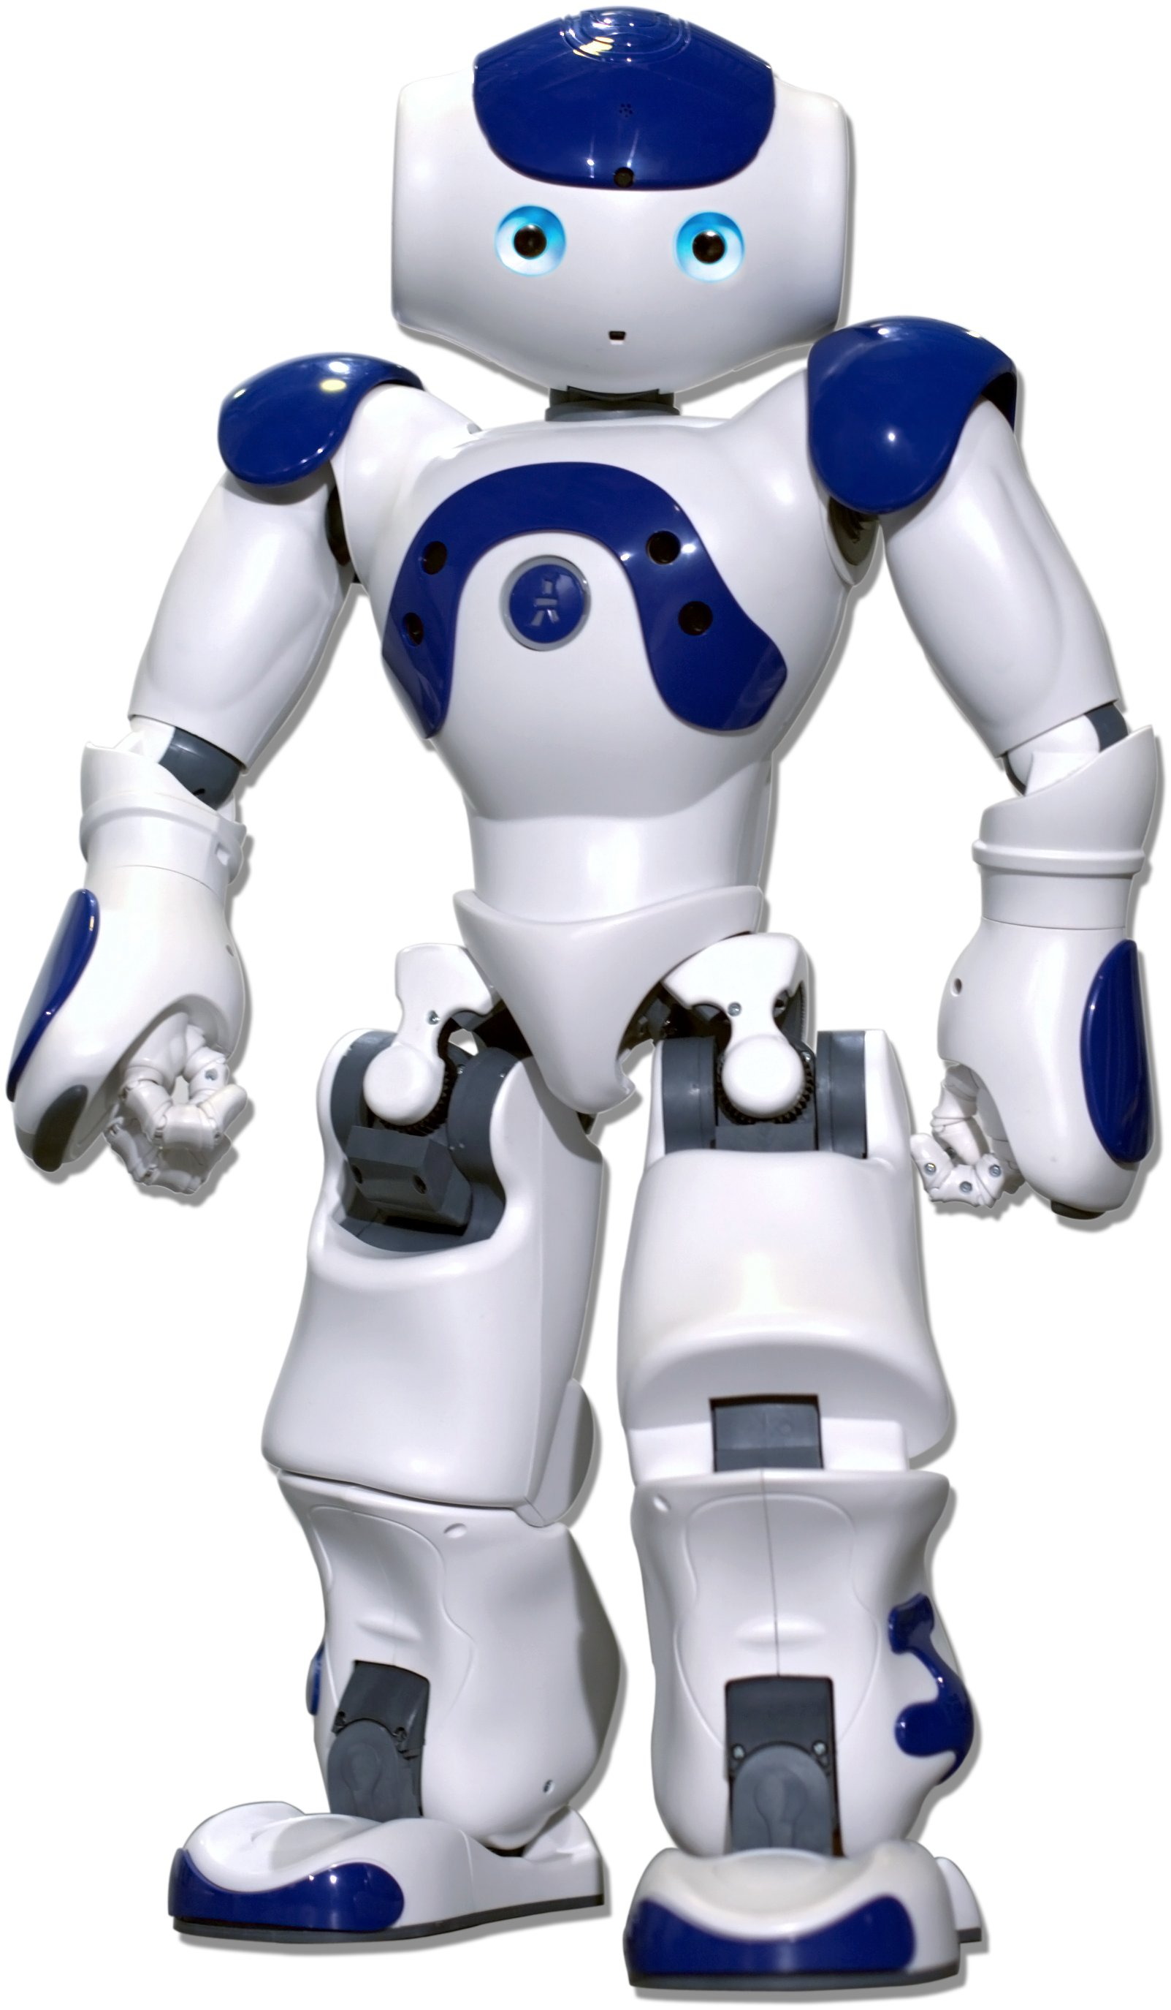

Generic Responses
“I don’t know“ problem (Sordoni et al., 2015; Serban et al.,2015; )
How old are you ?
I don’t know .
"A Diversity-Promoting Objective Function for Neural Conversation Models" – Li et al. 2016

Slide 54
Generic Responses
“I don’t know“ problem (Sordoni et al., 2015; Serban et al.,2015; )
How is life ?
I don’t know what you are talking about.
Notes:
30% percent. This behavior is ascribed

Slide 55
How to deal with Generic Responses
“I don’t know“ problem (Sordoni et al., 2015; Serban et al.,2015; )
Do you love me ?
I don’t know what you are talking about.
30% percent of all generated responses
Notes:
30% percent. This behavior is ascribed

Slide 56
How to deal with Generic Responses
Def ChatBot(string):
if string[len(string)-1] == “?”:
return “I don’t know”
else:
return “I don’t know what you are talking about”
Notes:
It is not unreasoble to generate . Developing a chatbot is not just about generating reasonable response

Slide 57
How to deal with Generic Responses
Def ChatBot(string):
if string[len(string)-1] == “?”:
return “I don’t know”
else:
return “I don’t know what you are talking about”
What Eliza is doing !!
Notes:
It is not unreasoble to generate . Developing a chatbot is not just about generating reasonable response

Slide 58
How to deal with Generic Responses
Solution #1: Adding Rules

Slide 59
How to deal with Generic Responses
Solution #1: Adding Rules
I don’t know .
I don’t know ..
I don’t know …
...
I don’t know !
I don’t know ! !
I don’t know ! ! !
Notes:
Regular expression matching

Slide 60
How to deal with Generic Responses
Solution #1: Adding Rules
I don’t have the foggiest idea what you are talking about .
I have no idea .
I don’t know .
I don’t know ..
I don’t know …
...
I don’t know !
I don’t know ! !
I don’t know ! ! !
I don’t have a clue.
I don’t have the lightest idea what you are talking about .
I haven’t the faintest idea
How should I know ?
Notes:
Unfortunately, deep learning model manage to cluster all phrases that are semantically related to I don’t know.
Most comprehensive “I don’t know” list I have ever seen …

Slide 61
How to deal with Generic Responses
Solution #1: Adding Rules
I don’t have the foggiest idea what you are talking about .
I have no idea .
I don’t know .
I don’t know ..
I don’t know …
...
I don’t know !
I don’t know ! !
I don’t know ! ! !
I don’t have a clue.
I don’t have the lightest idea what you are talking about .
I haven’t the faintest idea
How should I know ?
Rules don’t work !!
Notes:
Unfortunately, deep learning model manage to cluster all phrases that are semantically related to I don’t know.
Most comprehensive “I don’t know” list I have ever seen …

Slide 62
How to deal with Generic Responses
Solution #1: Adding Rules
I don’t have the foggiest idea what you are talking about .
All top responses are generic
I have no idea .
I don’t know .
I don’t know ..
I don’t know …
...
I don’t know !
I don’t know ! !
I don’t know ! ! !
I don’t have a clue.
I don’t have the lightest idea what you are talking about .
I haven’t the faintest idea
How should I know ?
Rules don’t work !!
Notes:
Unfortunately, deep learning model manage to cluster all phrases that are semantically related to I don’t know.
Most comprehensive “I don’t know” list I have ever seen …

Slide 63
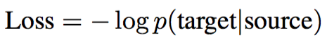
Mutual Information for Response Generation.

Slide 64
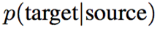
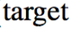
Mutual Information for Response Generation.

Slide 65
Mutual Information for Response Generation.
“I don’t know”
Whatever one asks
It's always going to be fairly high because it is safe

Slide 66

Mutual Information for Response Generation.
What one asks
“I don’t know”

Slide 67
Mutual Information for Response Generation.
“I don’t know”
Nothing unique will ever be more likely than something safe
What one asks
“I don’t know”
What one asks
The safe answer has lots of possible setups, none particularly likely
Notes:
The other way around

Slide 68
Mutual Information for Response Generation.
“I don’t know”
Nothing unique will ever be more likely than something safe
What one asks
“To the beach”
“I don’t know”
What one asks
The safe answer has lots of possible setups, none particularly likely
The interesting answer may have support for only one setup. So search for that interesting answer.
Notes:
The other way around

Slide 69
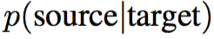
Mutual Information for Response Generation.

Slide 70
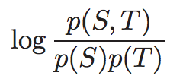
Mutual Information for Response Generation.
Mutual Information

Slide 71
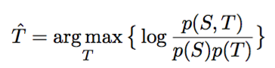
Mutual Information for Response Generation.

Slide 72
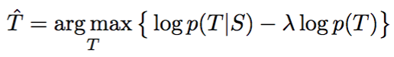
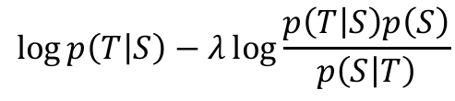
Mutual Information for Response Generation.
Just a heuristic
Bayes' Rule
$$\log{p\left(T | S\right)−λ\log{\frac{p\left(T | S\right)p\left(S\right)}{p\left(S | T\right)}}}$$
$$\log{p\left(T | S\right)−λ(log{p\left(T | S\right)+\log{p(S)}−\log{p\left(S | T\right)})}}$$
$$(1−λ)log{p\left(T | S\right)+λ\log{p\left(S | T\right)[−λ}\log{p(S)]}}$$

Slide 73
Mutual Information for Response Generation.
Bayes' Rule

Slide 74
Mutual Information for Response Generation.
Bayes' Rule
Implementation: Generate n-best lists and rerank!

Slide 75
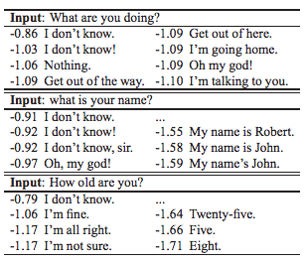
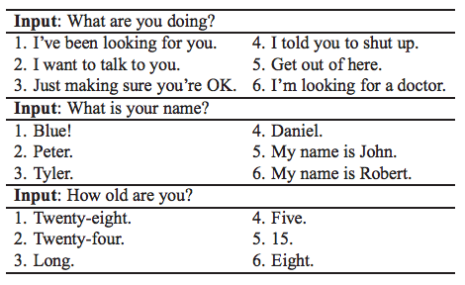
Sampled Results
Standard Seq2Seq p(t|s)
Mutual Information
Notes:
Too small

Slide 76
Problems
Generic responses
Speaker not consistent
Appropriate reward functions
(Work of Jiwei Li)

Slide 77
Speaker Consistency
How old are you ?
I’m 8 .
"A Persona-Based Neural Conversation Model" – Li et al. 2016

Slide 78
Speaker Consistency
How old are you ?
I’m 8 .
What’s your age?
18

Slide 79
Speaker Consistency
Where do you live now?
I live in Los Angeles.

Slide 80
Speaker Consistency
Where do you live now?
I live in Los Angeles.
In which city do you live now?
I live in Paris.

Slide 81
Speaker Consistency
Where do you live now?
I live in Los Angeles.
In which city do you live now?
I live in Paris.
In which country do you live now?
England, you?

Slide 82
Speaker Consistency
How old are you ?
I’m 8.

Slide 83
Speaker Consistency
How old are you ?
I’m 8.
How many kids do you have ?
4, you ?

Slide 84
Speaker Consistency
When were you born ?
In 1942.

Slide 85
Speaker Consistency
When were you born ?
In 1942.
When was your mother born ?
In 1966.
Notes:
You need a knowledgebase to tell you ..

Slide 86
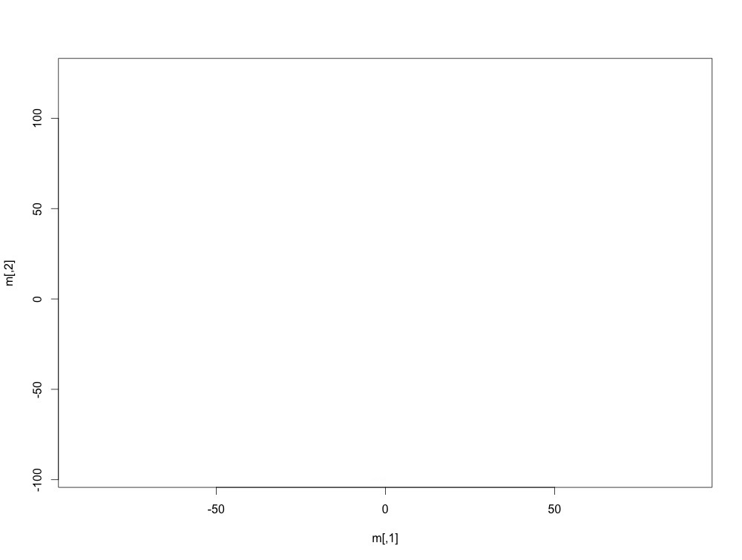
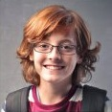

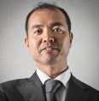
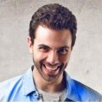
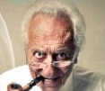
How to represent users
uk
london
great
sydney
good
Bob
Word embeddings (50k)
monday
live
okay
Persona embeddings (70k)
tuesday
stay

Slide 87
Persona seq2seq model
Encoding
Decoding
where
do
you
live
EOS

Slide 88
Persona seq2seq model
Encoding
Decoding
where
do
you
live
EOS
Bob
Bob
Persona embeddings (70k)

Slide 89
Persona seq2seq model
in
Encoding
Decoding
where
do
you
live
EOS
Bob
Bob
Persona embeddings (70k)

Slide 90
Persona seq2seq model
in
uk
Encoding
Decoding
where
do
you
live
EOS
Bob
in
Bob
Bob
Persona embeddings (70k)

Slide 91
Persona seq2seq model
in
uk
.
Encoding
Decoding
where
do
you
live
EOS
Bob
in
Bob
uk
Bob
Bob
Persona embeddings (70k)

Slide 92
Persona seq2seq model
in
uk
.
EOS
Encoding
Decoding
where
do
you
live
EOS
Bob
in
Bob
uk
Bob
.
Bob
uk
london
Bob
great
sydney
good
Word embeddings (50k)
Persona embeddings (70k)
monday
live
okay
tuesday
stay
Notes:
If you ask one user 100 questions, the 100 responses you will generate are not independent because the same user representation will be incoproaated

Slide 93
Interaction Seq2Seq model
Encoding
where
do
you
live
Notes:
speaker-addressee interaction patterns within the conversation.
Add speaker, addresse

Slide 94
Interaction Seq2Seq model
Encoding
where
do
you
live
tanh(W* )

Slide 95
Interaction Seq2Seq model
in
Encoding
Decoding
where
do
you
live
EOS
tanh(W* )

Slide 96
Interaction Seq2Seq model
in
uk
Encoding
Decoding
where
do
you
live
EOS
in
tanh(W* )

Slide 97
Interaction Seq2Seq model
in
uk
.
Encoding
Decoding
where
do
you
live
EOS
in
uk

Slide 98
Where Does The Data Come From?
Train on persona-labeled data sets
Twitter firehose sample from 2012 (not available to most)
Twitter collection from Sordoni et al. 2015 (you can download tweet IDs)
Transcripts of Friends, Big Bang Theory
At test time, just choose a persona and stick with it

Slide 99
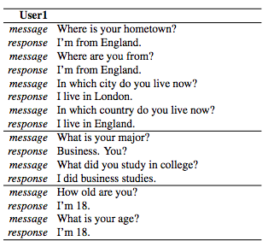
Results (No cherry-picking)

Slide 100
Results (No cherry-picking)

Slide 101
Results (No cherry-picking)

Slide 102
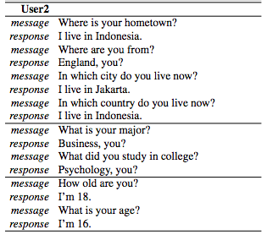
Results (No cherry-picking)

Slide 103
Problems
Generic responses
Speaker not consistent
Appropriate reward functions
(Work of Jiwei Li)

Slide 104
Issues
How do we handle long-term dialogue success?
Problem 1: Dull and generic responses.
"Deep Reinforcement Learning for Dialogue Generation" – Li et al. 2016

Slide 105
Issues
Problem 1: Dull and generic responses.
“I don’t know“ problem (Sordoni et al., 2015; Serban et al.,2015; )
Do you love me ?
I don’t know what you are talking about.

Slide 106
Issues
How do we handle long-term dialogue success?
Problem 1: Dull and generic responses.
Problem 2: Repetitive responses.

Slide 107
Problem 2: Repetitive responses.
Shut up !

Slide 108
Problem 2: Repetitive responses.
Shut up !
No, you shut up !

Slide 109
Problem 2: Repetitive responses.
Shut up !
No, you shut up !
No, you shut up !

Slide 110
Problem 2: Repetitive responses.
Shut up !
No, you shut up !
No, you shut up !
No, you shut up !

Slide 111
Problem 2: Repetitive responses.
Shut up !
No, you shut up !
No, you shut up !
No, you shut up !
No, you shut up !
……

Slide 112
Problem 2: Repetitive responses.
See you later !
See you later !
See you later !
See you later !
See you later !
……

Slide 113
Issues
How do we handle long-term dialogue success?
Problem 1: Dull and generic responses.
Problem 2: Repetitive responses.
Problem 3: Short-sighted conversation decisions.

Slide 114
Problem 3: Short-sighted conversation decisions.
How old are you ?

Slide 115
Problem 3: Short-sighted conversation decisions.
How old are you ?
i 'm 16 .

Slide 116
Problem 3: Short-sighted conversation decisions.
How old are you ?
i 'm 16 .
16 ?

Slide 117
Problem 3: Short-sighted conversation decisions.
How old are you ?
i 'm 16 .
16 ?
i don 't know what you 're talking about

Slide 118
Problem 3: Short-sighted conversation decisions.
How old are you ?
i 'm 16 .
16 ?
i don 't know what you 're talking about

Slide 119
Problem 3: Short-sighted conversation decisions.
How old are you ?
i 'm 16 .
16 ?
i don 't know what you 're talking about
you don 't know what you 're saying

Slide 120
Problem 3: Short-sighted conversation decisions.
How old are you ?
i 'm 16 .
16 ?
i don 't know what you 're talking about
you don 't know what you 're saying
i don 't know what you 're talking about

Slide 121
Problem 3: Short-sighted conversation decisions.
How old are you ?
i 'm 16 .
16 ?
i don 't know what you 're talking about
you don 't know what you 're saying
i don 't know what you 're talking about
you don 't know what you 're saying

Slide 122
Problem 3: Short-sighted conversation decisions.
Bad Action
How old are you ?
i 'm 16 .
16 ?
i don 't know what you 're talking about
you don 't know what you 're saying
i don 't know what you 're talking about
you don 't know what you 're saying

Slide 123
Problem 3: Short-sighted conversation decisions.
How old are you ?
i 'm 16 .
16 ?
i don 't know what you 're talking about
you don 't know what you 're saying
i don 't know what you 're talking about
you don 't know what you 're saying
Outcome

Slide 124
Can reinforcement learning handle this?
How old are you ?
i 'm 16 .
16 ?
i don 't know what you 're talking about
you don 't know what you 're saying
i don 't know what you 're talking about
you don 't know what you 're saying
Outcome does not emerge until a few turns later

Slide 125
Can reinforcement learning handle this?
RL in a nutshell: you're in a state, you can take some actions, at some point you get a reward. Change behavior to maximize your expected reward
Supervised Learning: For every data item, you know if your labels are right or wrong and by how much
Unsupervised Learning: You have a bunch of unlabeled data, and nobody ever tells you anything about your labels
Reinforcement Learning: You occasionally get feedback on how you're doing but not about the specific labels

Slide 126
Notations for Reinforcement Learning

Slide 127
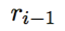
Notations: State
How old are you ?
how
old
are
you
Encoding

Slide 128
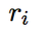
Notations: Action
How old are you ?
i 'm 16 .

Slide 129
Notations: Reward

Slide 130
Notations: Reward
How old are you ?
i 'm 16 .

Slide 131
Notations: Reward
1. Ease of answering

Slide 132
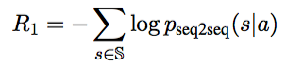
Notations: Reward
1. Ease of answering

Slide 133
Notations: Reward
1. Ease of answering
S: ”I don’t know what you are talking about”
And other "boring" responses. We want to discourage generating a response the model will "bore out" on.
Notes:
We propose to measure the ease of answering a generated turn by using the negative log likelihood of reponding to that utterance with a dull response

Slide 134
Notations: Reward
2. Information Flow

Slide 135
Notations: Reward
2. Information Flow
See you later !
See you later !
See you later !
See you later !

Slide 136
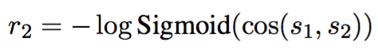
Notations: Reward
2. Information Flow
See you later !
S1
See you later !
S2

Slide 137
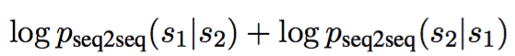
Notations: Reward
3. Meaningfulness
S1
How old are you ?
S2
i 'm 16 .

Slide 138
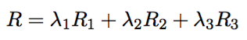
Notations: Reward
Easy to answer R1
Information Flow R2
Meaningfulness R3

Slide 139
Simulation
A message from training set

Slide 140
Simulation
Encode
A message from training set

Slide 141
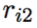
Simulation
Encode
A message from training set
Decode
r1
…

Slide 142
Simulation
Encode
A message from training set
Encode
Decode
r1
…

Slide 143
Simulation
Encode
A message from training set
Encode
Decode
r1
Decode
r2
…

Slide 144
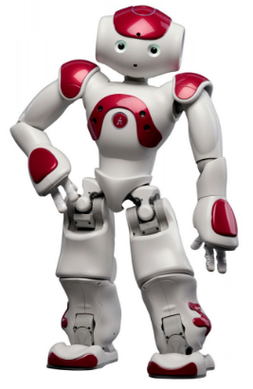
Turn 1
Turn 2
Turn N
…
Input
Message
Encode
Decode
Encode
Decode
Encode
Decode
S1
S2
Sn

Slide 145
Turn 1
Turn 2
Turn N
…
Input
Message
Encode
Decode
Encode
Decode
Encode
Decode
S1
S2
Sn
Compute Accumulated Reward R(S1,S2,…,Sn)

Slide 146
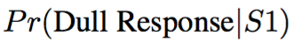
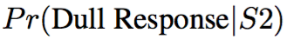
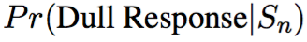
Turn 1
Turn 2
Turn N
…
Input
Message
Encode
Decode
Encode
Decode
Encode
Decode
S1
S2
Sn
Easy to answer

Slide 147
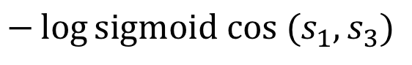
Turn 1
Turn 2
Turn N
…
Input
Message
Encode
Decode
Encode
Decode
Encode
Decode
S1
S2
S3
Easy to answer R1
Information Flow R2
$$−\log{\text{sigmoid} cos⁡ (s_{1},s_{3})}$$
Don't repeat yourself!

Slide 148
Turn 1
Turn 2
Turn N
…
Input
Message
Encode
Decode
Encode
Decode
Encode
Decode
S1
S2
S3
Easy to answer R1
Information Flow R2
Meaningfulness R3
MMI (from before)

Slide 149
Turn 1
Turn 2
Turn N
…
Input
Message
Encode
Decode
Encode
Decode
Encode
Decode
S1
S2
S3
Easy to answer R1
Information Flow R2
Meaningfulness R3

Slide 150
Turn 1
Turn 2
Turn N
…
Input
Message
Encode
Decode
Encode
Decode
Encode
Decode
S1
S2
S3
Easy to answer R1
Information Flow R2
Meaningfulness R3
Compute Accumulated Reward R(S1,S2,…,Sn)

Slide 151
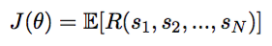
Turn 1
Turn 2
Turn N
…
Input
Message
Encode
Decode
Encode
Decode
Encode
Decode
S1
S2
Sn
REINFORCE Algorithm (William,1992)

Slide 152
Turn 1
Turn 2
Turn N
…
Input
Message
Encode
Decode
Encode
Decode
Encode
Decode
S1
S2
Sn
REINFORCE Algorithm (William,1992)

Slide 153
Turn 1
Turn 2
Turn N
…
Input
Message
Encode
Decode
Encode
Decode
Encode
Decode
S1
S2
Sn
REINFORCE Algorithm (William,1992)

Slide 154
Turn 1
Turn 2
Turn N
…
Input
Message
Encode
Decode
Encode
Decode
Encode
Decode
S1
S2
Sn
REINFORCE Algorithm (William,1992)

Slide 155
Turn 1
Turn 2
Turn N
…
Input
Message
Encode
Decode
Encode
Decode
Encode
Decode
S1
S2
Sn
REINFORCE Algorithm (William,1992)

Slide 156
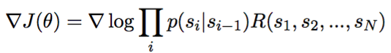
Turn 1
Turn 2
Turn N
…
Input
Message
Encode
Decode
Encode
Decode
Encode
Decode
S1
S2
Sn
REINFORCE Algorithm (William,1992)

Slide 157
Turn 1
Turn 2
Turn N
…
Input
Message
Encode
Decode
Encode
Decode
Encode
Decode
S1
S2
Sn
REINFORCE Algorithm (William,1992)
Typical gradient...
With extra score!
What we want to learn

Slide 158
Results
Input | Mutual Information | The proposed model
How old are you ? | I’m 16. | I’m 16. why are you asking ?
what is your full name ? | i have no idea | what 's yours ?
I don 't want to go home tonight . | Really ? | Why ?
Do you have any feelings for me ? | I don’t know what you are talking about. | Would I see you if I didn 't ?

Slide 159
Results
Input | Mutual Information | The proposed model
How old are you ? | I’m 16. | I’m 16. why are you asking ?
what is your full name ? | i have no idea | what 's yours ?
I don 't want to go home tonight . | Really ? | Why ?
Do you have any feelings for me ? | I don’t know what you are talking about. | Would I see you if I didn 't ?

Slide 160
Results
Input | Mutual Information | The proposed model
How old are you ? | I’m 16. | I’m 16. why are you asking ?
what is your full name ? | i have no idea | what 's yours ?
I don 't want to go home tonight . | Really ? | Why ?
Do you have any feelings for me ? | I don’t know what you are talking about. | Would I see you if I didn 't ?

Slide 161
Results
Input | Mutual Information | The proposed model
How old are you ? | I’m 16. | I’m 16. why are you asking ?
what is your full name ? | i have no idea | what 's yours ?
I don 't want to go home tonight . | Really ? | Why ?
Do you have any feelings for me ? | I don’t know what you are talking about. | Would I see you if I didn 't ?

Slide 162
Simulation
How old are you ?

Slide 163
Simulation
How old are you ?
i 'm 16, why are you asking ?

Slide 164
Simulation
How old are you ?
i 'm 16, why are you asking ?
I thought you were 12 .

Slide 165
Simulation
How old are you ?
i 'm 16, why are you asking ?
I thought you were 12 .
What made you think so ?

Slide 166
Simulation
How old are you ?
i 'm 16. why are you asking ?
I thought you were 12 .
What made you think so ?
I don’t know what you are talking about .

Slide 167
Simulation
How old are you ?
i 'm 16, why are you asking ?
I thought you were 12 .
What made you think so ?
I don’t know what you are talking about .
You don’t know what you are saying.

Slide 168
Simulation
How old are you ?
i 'm 16, why are you asking ?
I thought you were 12 .
What made you think so ?
I don’t know what you are talking about .
You don’t know what you are saying.
I don’t know what you are talking about .

Slide 169
Simulation
Survive 4 turns !!
How old are you ?
i 'm 16, why are you asking ?
I thought you were 12 .
What made you think so ?
I don’t know what you are talking about .
You don’t know what you are saying.
I don’t know what you are talking about .

Slide 170
Reward for Good Dialogue
"Adversarial Learning for Neural Dialogue Generation" – Li et al. 2017

Slide 171
Reward for Good Dialogue
How to evaluate open domain dialogue generation

Slide 172
Reward for Good Dialogue
How to evaluate open domain dialogue generation
Bleu ? Ppl ?

Slide 173
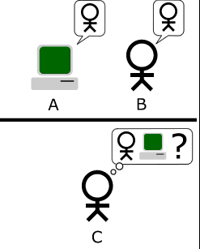
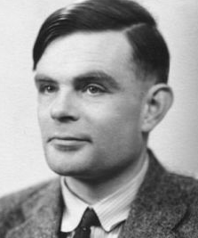
Reward for Good Dialogue
Turing Test
Notes:
Keep an on

Slide 174
Reward for Good Dialogue
Turing Test
I’m 25.
Input
How old are you ?

Slide 175
Reward for Good Dialogue
Turing Test
I’m 25.
Input
How old are you ?
I don’t know what you are talking about

Slide 176
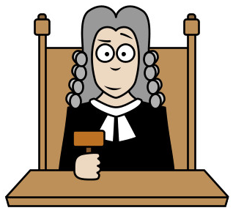
Reward for Good Dialogue
Turing Test
I’m 25.
How old are you ?
I don’t know what you are talking about
A human evaluator/ judge

Slide 177
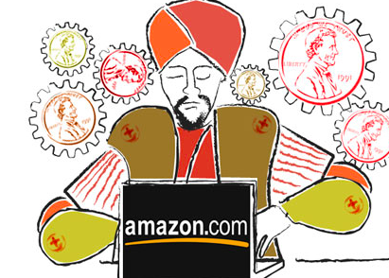
Reward for Good Dialogue
Turing Test
I’m 25.
How old are you ?
I don’t know what you are talking about
A human evaluator/ judge

Slide 178
Reward for Good Dialogue
Turing Test
I’m 25.
How old are you ?
I don’t know what you are talking about
Too expensive ?

Slide 179

Reward for Good Dialogue
I’m 25.
How old are you ?
I don’t know what you are talking about

Slide 180


Reward for Good Dialogue
P= 90% human generated
I’m 25.
How old are you ?
I don’t know what you are talking about
P= 10% human generated

Slide 181
Reward for Good Dialogue
P= 90% human generated
I’m 25.
How old are you ?
I don’t know what you are talking about
P= 10% human generated

Slide 182
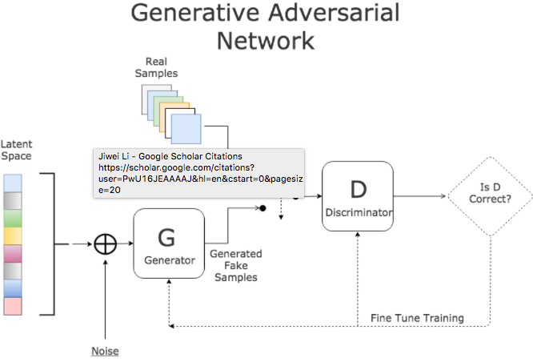
Adversarial Learning in
Image Generation (Goodfellow et al., 2014)
P= 90% human generated
I’m 25.
Discriminator
I don’t know what you are talking about
P= 10% human generated

Slide 183
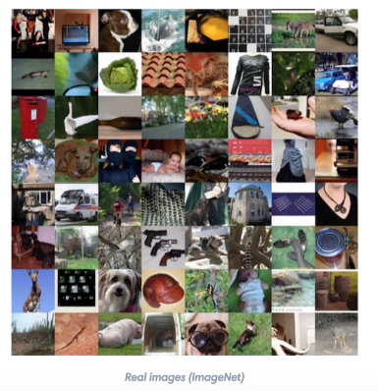
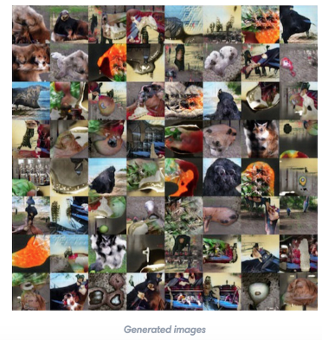
Adversarial Learning in
Image Generation (Goodfellow et al., 2014)
P= 90% human generated
Discriminator
P= 10% human generated

Slide 184
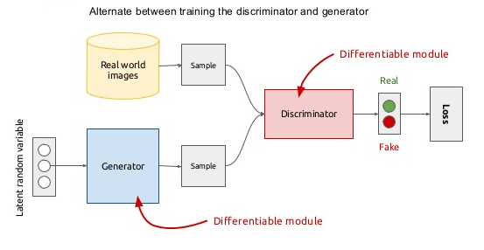
Adversarial Learning in
Image Generation (Goodfellow et al., 2014)

Slide 185
Model Break Down
I’m
fine
.
EOS
Generation Model (G)
Encoding
Decoding
how
are
you
?
eos
I’m
fine
.

Slide 186
Model Break Down
I’m
fine
.
EOS
Generation Model (G)
Encoding
Decoding
how
are
you
?
eos
I’m
fine
.
Discrimination Model (D)
how
are
you
?
eos
I’m
fine
.

Slide 187
Model Break Down
I’m
fine
.
EOS
Generation Model (G)
Encoding
Decoding
how
are
you
?
eos
I’m
fine
.
Discrimination Model (D)
how
are
you
?
eos
I’m
fine
.

Slide 188
Model Break Down
I’m
fine
.
EOS
Generation Model (G)
Encoding
Decoding
how
are
you
?
eos
I’m
fine
.
Discrimination Model (D)
P= 90% human generated
how
are
you
?
eos
I’m
fine
.

Slide 189
Model Break Down
I’m
fine
.
EOS
Generation Model (G)
Encoding
Decoding
how
are
you
?
eos
I’m
fine
.
Discrimination Model (D)
Reward
P= 90% human generated
how
are
you
?
eos
I’m
fine
.

Slide 190
Policy Gradient
Generation Model (G)
I’m
fine
EOS
Encoding
Decoding
how
are
you
?
eos
I’m
fine
.
REINFORCE Algorithm (William,1992)

Slide 191
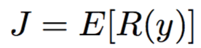
Policy Gradient
Generation Model (G)
I’m
fine
EOS
Encoding
Decoding
how
are
you
?
eos
I’m
fine
.
REINFORCE Algorithm (William,1992)

Slide 192
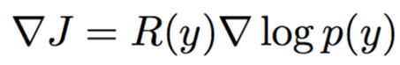
Policy Gradient
Generation Model (G)
I’m
fine
EOS
Encoding
Decoding
how
are
you
?
eos
I’m
fine
.
REINFORCE Algorithm (William,1992)

Slide 193
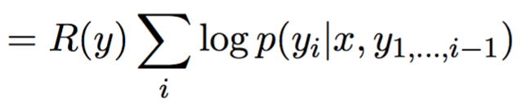
Policy Gradient
Generation Model (G)
I’m
fine
EOS
Encoding
Decoding
how
are
you
?
eos
I’m
fine
.
REINFORCE Algorithm (William,1992)

Slide 194
Policy Gradient
Generation Model (G)
I’m
fine
EOS
Encoding
Decoding
how
are
you
?
eos
I’m
fine
.

Slide 195
Policy Gradient
Generation Model (G)
I’m
fine
EOS
Encoding
Decoding
how
are
you
?
eos
I’m
fine
.
Same reward to all tokens

Slide 196
Policy Gradient
Input : What’s your name
human : I am John
machine : I don’t know

Slide 197
Policy Gradient
Input : What’s your name
human : I am John
machine : I don’t know
REINFORCE assigns the same negative reward to all tokens [I, don’t, know]

Slide 198
Policy Gradient
Input : What’s your name
human : I am John
machine : I don’t know
REINFORCE assigns the same negative reward to all tokens [I, don’t, know]
Negative reward for “ I “

Slide 199
Policy Gradient
Input : What’s your name
human : I am John
machine : I don’t know
REINFORCE assigns the same negative reward to all tokens [I, don’t, know]
Reward for Every Generation Step (REGS)

Slide 200
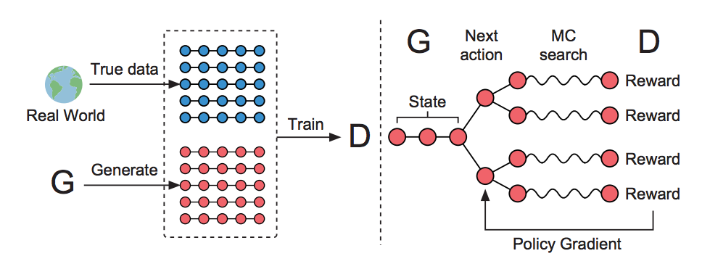
Policy Gradient
Monte Carlo Search
Figure from Yu et al (2016)

Slide 201
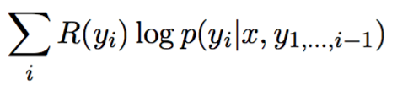
Policy Gradient
Generation Model (G)
I’m
fine
EOS
Encoding
Decoding
how
are
you
?
eos
I’m
fine
.

Slide 202
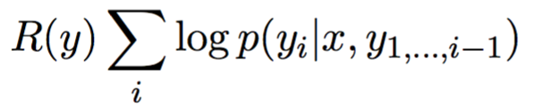
Policy Gradient
Generation Model (G)
I’m
fine
EOS
Encoding
Decoding
how
are
you
?
eos
I’m
fine
.
Difference

Slide 203
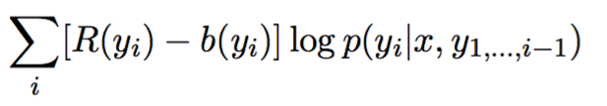
Policy Gradient
Generation Model (G)
I’m
fine
EOS
Encoding
Decoding
how
are
you
?
eos
I’m
fine
.
Actor-critic RL

Slide 204

Adversarial Evaluation: "Adversarial Success"
How often a system can fool a computer into believing that its generated response was from a human
I think "P= 90% human generated"
I don't know
How are you?
The machine evaluator is fooled!!!

Slide 205
Results: Adversarial Learning Improves Response Generation
vs a vanilla generation model
Adversarial Win | Adversarial Lose | Tie
62% | 18% | 20%
Human Evaluator
Adversarial Success
(How often can you fool a machine)
Adversarial Learning | 8.0
Standard Seq2Seq model | 4.9
Machine Evaluator

Slide 206
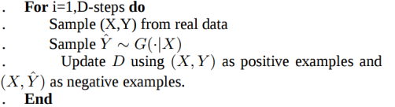

Adversarial Learning for Neural Dialogue Generation
Update the Discriminator
Update the Generator
The discriminator forces the generator to produce correct responses

Slide 207

Human Evaluation
The previous RL model only perform better on multi-turn conversations

Slide 208
Sample response
Tell me ... how long have you had this falling sickness ?
System | Response
Vanilla-MLE | I’m not a doctor.
Vanilla-Sample | Well everything you did was totally untrue.
REINFORCE | I don’t know how long it’s been.
REGS Monte Carlo (Reward for Every Generation Step) | A few months, I guess.

Slide 209
Chatbots: pro and con
Pro:
Fun
Applications to counseling
Good for narrow, scriptable applications
Cons:
They don't really understand
Rule-based chatbots are expensive and brittle
IR-based chatbots can only mirror training data
The case of Microsoft Tay
(or, Garbage-in, Garbage-out)
Neural chatbots: seem much better but still don't really understand
The future: combining chatbots with frame-based agents

